Slide 1



Socioeconomic factors in relation to Autism Spectrum Disorders
Dheeraj Rai and Selma Idring
17 March 2014
Dheeraj.rai@bristol.ac.uk

Slide 2

The usual fate of postprandial talks!

Slide 3
Background
Socioeconomic gradients are observed in many physical and mental health conditions
Lower SES Poorer Health

Slide 4
But ...
Higher maternal education offspring Autism
Consistent finding in contemporary US studies (Bhasin 2007, Croen 2002, Durkin 2010, Van Meter 2010 etc)

Slide 5


Slide 6
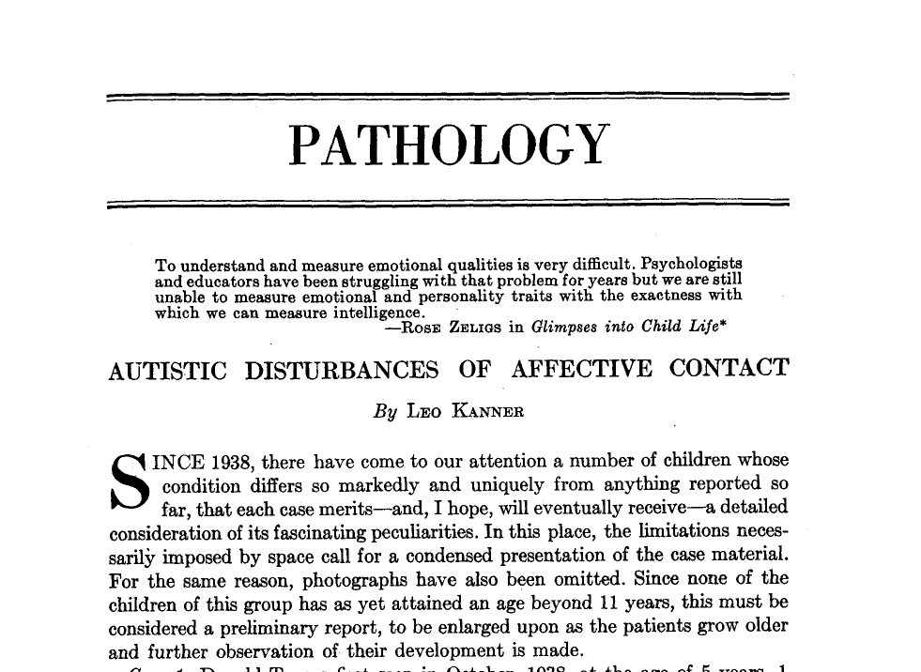

Slide 7
Issue widely debated after Kanner’s initial descriptions
Relatively less recent attention
But high SES-autism relationship still consistently observed (Bhasin 2007, Croen 2002, Durkin 2010, Van Meter 2010 etc)

Slide 8
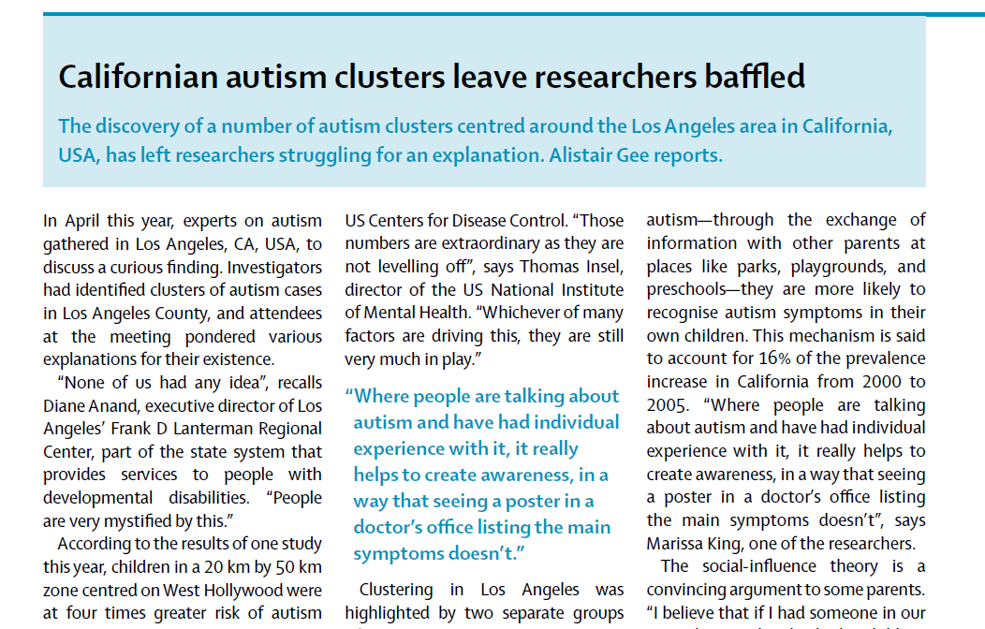

Slide 9
Why these SES gradients?
Greater awareness and access to ASD diagnosis in high SES parents?
Perception of clinicians?
Etiological significance?
Desirability of the label?

Slide 10
Usual differential or mis-diagnoses
Learning disabilities/ Mental Retardation/ Intellectual disability
Schizophrenia
Personality disorders

Slide 11
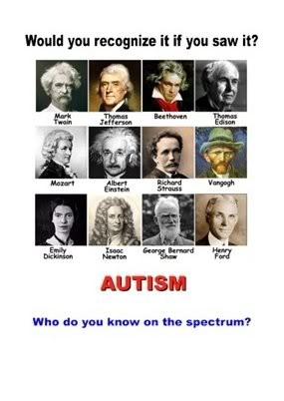

Slide 12
Some studies have also found the opposite SES gradients
A lower parental income associated with ASD in a Danish study (attenuated on adjustment for possible mediators) (Larsson 2005)
Parental income support during pregnancy associated with ASD in a Canadian study (Dodds 2011)
Less attention to these findings but may be important to highlight access inequalities

Slide 13
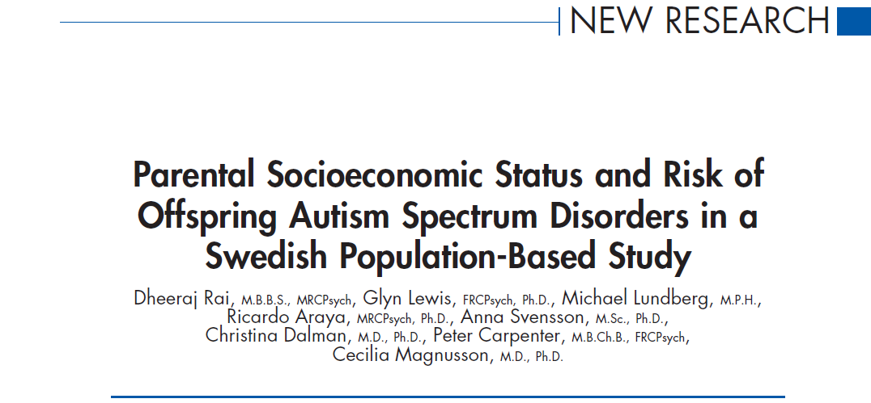
Study 1
J Am Acad Child & Adolesc Psychiatry May 2012

Slide 14
Aim
To test the hypothesis that measures of lower parental SES would be associated with ASD in Sweden

Slide 15
Swedish system- regular screening of all children in well baby clinics.
Public system, free of charge, same provider
Multidisciplinary protocols for diagnosis
Record of service use in various Swedish registries allowing record linkage studies

Slide 16
Materials and Methods
Stockholm Youth Cohort (SYC)
Register-linkage based cohort
0-17 year olds living in Stockholm County from 2001-onwards
N=735 096 (2011), n=589114 (2007)
Multisource ASD case ascertainment
ASD classified by comorbid ID (intellectual disability/ mental retardation)
ID = important prognostic factor (Howlin et 2004)
Support of classification of ASD by ID (Szatmari et al 2007, Lord et al 2012)

Slide 17
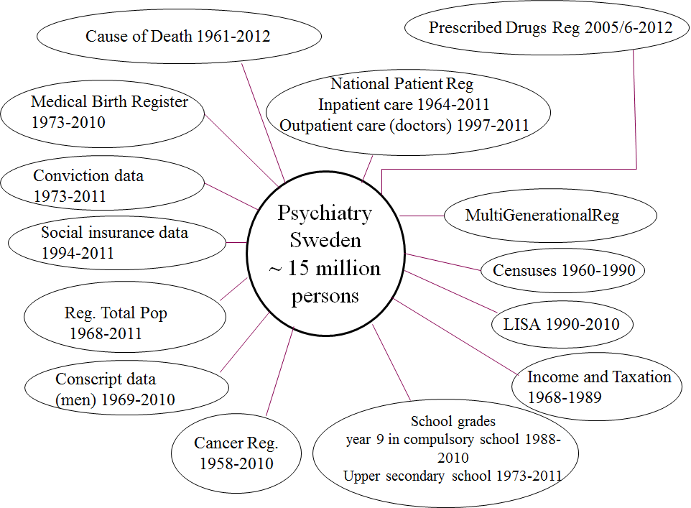
S. Wicks 2013
Notes:
The Stockholm youth cohort is part of a bigger research program about mental illnesses/ psychiatric disorders in a research group of the Department of Public health sciences
By registration of data in Swedish registers we have the possibility not only to look at various factors like perinatal characteristics and SES in the index individuals, but also their relatives, which we find through the Multi Generational Register

Slide 18
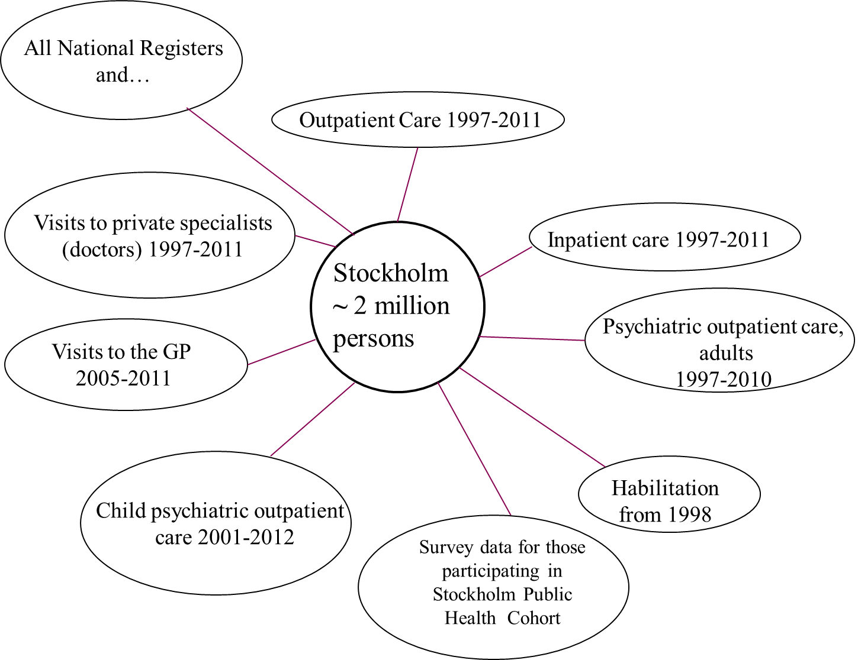
ASD case ascertainment in SYC
VAL/ Public Health care service in SCC 44% of ASD cases
Inpatient Register 14%
58% of ASD cases
68% of ASD cases
S. Wicks 2013
Notes:
What proportion of our cases do we find in which register?
Also from these registers we can obtain information on parental psychiatric care although data is poor concerning ASD in parents

Slide 19
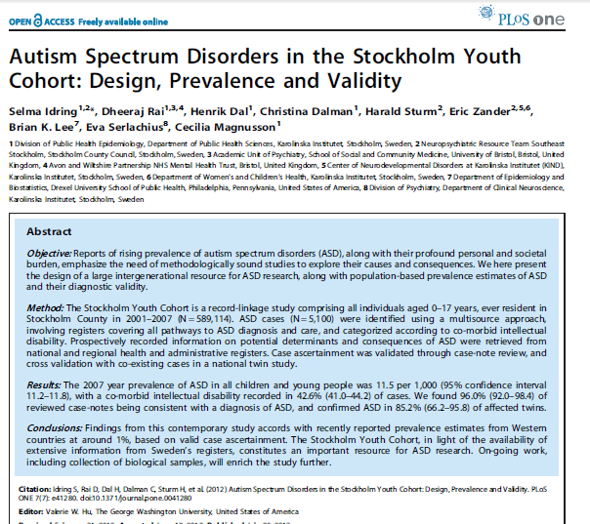
Notes:
The aims of this paper were to
Present SYC study design which I told you a little bit about already
Present year 2007 prevalence of ASD
Perform validation study of ASD case ascertainment by clinical case record note review (n=200)

Slide 20
Validation of ASD case ascertainment
Clinical Case record review
96% of ASD cases confirmed
Validation against CATSS
89% of ASD cases confirmed
1% of non-case twins in SYC (27 out of 2721 non-case twins) was classified as ASD in the CATSS
Notes:
cross-validation against CATSS (the Child and Adolescent Twin Study in Sweden; ASD assessed via parental report and A-TAC a comprehensive and reliable interview for neurodevelopmental disorder. We identified all twins two were found both in CATSS and the SYC. We found 27 twins who were identified to have ASD in the SYC)

Slide 21
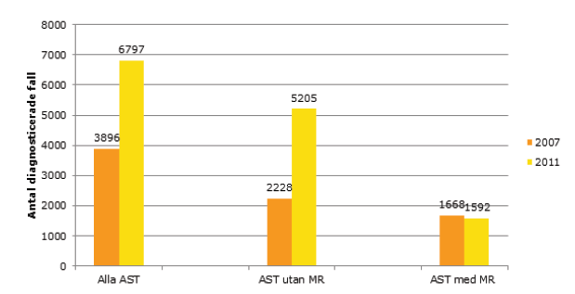
Year 2011 vs 2007 ASD prevalence among 0-17 year olds
Notes:
Add 4 years to the SYC

Slide 22
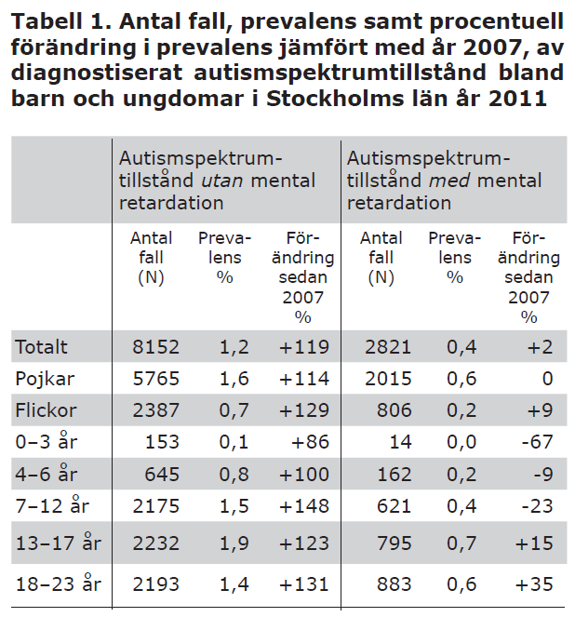

Slide 23
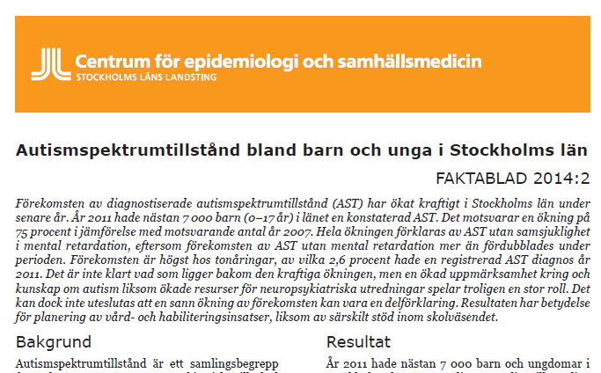
www.folkhalsoguiden.se

Slide 24
Parental SES and autism in SYC
Matched case-control study nested within the Stockholm Youth Cohort (1:10 matching on birth date and sex)

Slide 25
Methods
Parental SES characteristics (Exposures)
Household Income- equivalized and adjusted for inflation
Education
Occupational class
at time of birth of child (combined, separately)

Slide 26
Methods
Outcome
ASD, and ASD with or without Intellectual disability
Covariates
Parental ages, migration status, birth parity, parental psychiatric conditions
Birth weight for gestational age, gestational age at birth, Apgar score at 5 minutes, maternal smoking at first antenatal interview
Conditional logistic regression analysis to derive Odds Ratios (estimates of RR)

Slide 27
Results
4709 ASD cases, 46489 controls with complete data

Slide 28
Adjusted for maternal and paternal age, education, occupation, migration status, parity and parental psychiatric service use

Slide 29
Adjusted for maternal and paternal age, income, occupation, migration status, parity and parental psychiatric service use

Slide 30
Adjusted for maternal and paternal age, income, education, migration status, parity and parental psychiatric service use

Slide 31
Results similar for ASD with and without Intellectual disabilities
Results similar when education and occupation of either parent coded separately

Slide 32
Lower not higher parental SES associated with ASD in Sweden
Results opposite of US studies but similar to Denmark and Canada
Results consistent with SES gradients in other conditions including ID, and other child developmental outcomes.
Studies finding the opposite underestimating burden of ASD in lower SES groups?
Researchers should consider that social patterning of ASD may be similar to other health conditions.
?Aetiological significance; ? Genes; ?Environment

Slide 33
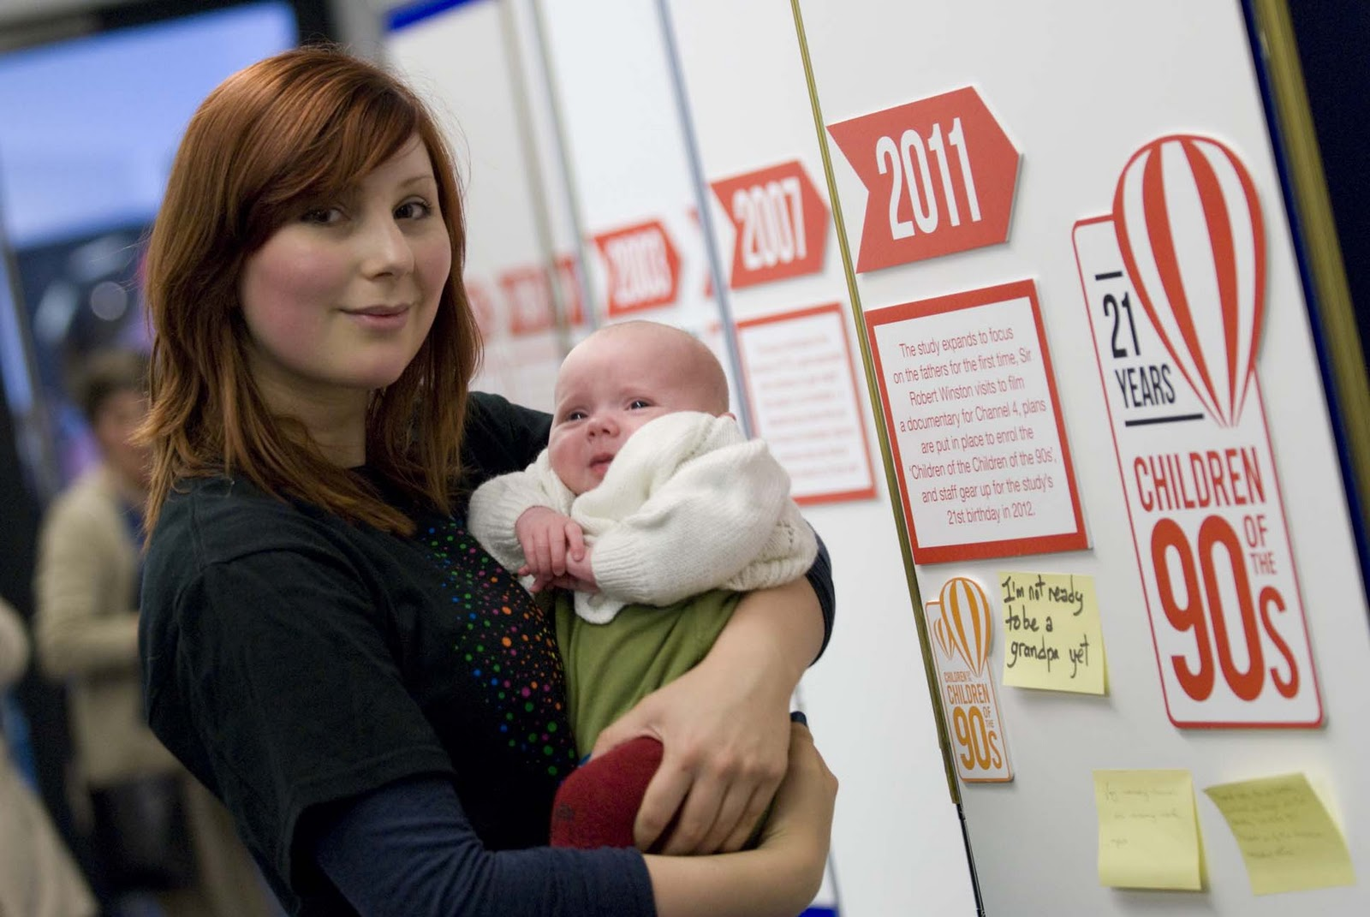

Study 2: Avon Longitudinal Study of Parents and Children

Slide 34
ALSPAC
Large birth cohort study in Bristol area of England
Approx 14,000 mothers recruited in pregnancy 1991-92
Data from Questionnaires, clinical assessments, biological samples, record linkage available on mothers and children during pregnancy and multiple times since then
By age 11, over 93 different autistic trait measures had been measured (Steer et al 2011, Plos One)
Diagnosis of ASD ascertained from medical and school records

Slide 35
In ALSPAC, children from low SES families have higher risk of autistic traits
BUT
Those who get the diagnosis of autism appear to be from high SES families

Slide 36
Conclusions
Autism may be more common in socioeconomically disadvantaged groups
It is these (low SES) groups where autism is also less likely to be recognised
This socioeconomic bias in diagnostic labelling needs to be further discussed and addressed

Slide 37
Thank You!

